Slide 1
Database Systems
COMP 3010E FALL 2025
Lecture 9 PL/SQL

Slide 2
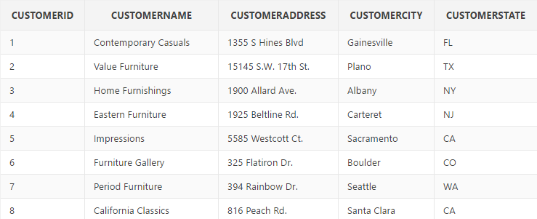
Cursor
  Defined and declared by the programmer
  For any query that returns more than one row of data
  Used to loop through every row of the query result
A tool to go through each row in a query result
Cursor

Slide 3
Cursor FOR Loop
  Looping through the rows of a table using “Cursor” in a For loop
  Syntax
FOR cursor_record IN c_cursor_name
LOOP
Action;
END LOOP;
NOTE:
The cursor_record is implicitly defined variable – no need to declare in the declaration section;
The cursor_record is served as a loop counter, sweeping over each row of the cursor;
The cursor_record is initialized to the first row of the cursor, and moves forward to the next row after each iteration;
NO IN REVERSE can be used in Cursor FOR loop.

Slide 4
Example
DECLARE
CURSOR c_customer_state IS
SELECT customerid AS ID, customername AS NAME, customerstate AS STATE
FROM customer_T;
BEGIN
FOR v_customer IN c_customer_state
LOOP
DBMS_OUTPUT.PUT_LINE(v_customer.id || ': ' || v_customer.name || ' is in ' || v_customer.state);
END LOOP;
END;
Define the cursor using a regular SQL query
v_customer is a record holder to retrieve each row in cursor
Use record.colname to reference each field in the row
The record holder is only valid inside FOR LOOP
Can’t be used outside LOOP

Slide 5
Example
Define a cursor that contains the product ID/description/price of all “Desks” in the product table. Then use either cursor loop or cursor FOR loop to display on the screen the ID, description, its original price, and the new price with a 10% discount.
DECLARE
v_new_price product_T.productstandardprice%TYPE;
CURSOR c_desk IS
SELECT productid AS ID, productdescription AS DES, productstandardprice AS PRICE
FROM product_T
WHERE productdescription like '%Desk';
BEGIN
FOR v_desk IN c_desk
LOOP
v_new_price := v_desk.price * 0.9;
DBMS_OUTPUT.PUT_LINE(v_desk.id || ': ' || v_desk.des || '; old_price is $' || v_desk.price ||
'; new_price is $' || ROUND(v_new_price, 2) );
END LOOP;
END;
3: Computer Desk; old_price is $375; new_price is $337.5
5: Writers Desk; old_price is $325; new_price is $292.5
6: 8-Drawer Desk; old_price is $750; new_price is $675
8: Computer Desk; old_price is $250; new_price is $225

Slide 6
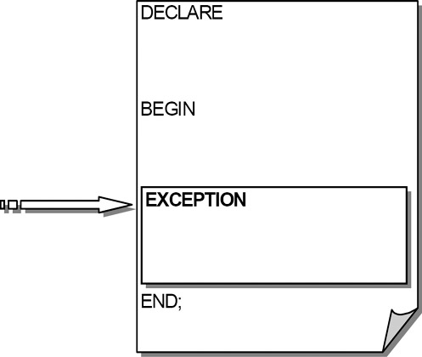
Exceptions

Slide 7
Error Handling
  Two types of errors
    compilation errors:
    -- a.k.a. syntax error; can be detected by the compiler
    runtime errors
    -- can NOT be detected by the complier
    -- exception handler
DECLARE
v_num1 INTEGER := :bv_n1;
v_num2 INTEGER := :bv_n2;
v_result NUMBER;
BEGIN
v_result = v_num1 / v_num2;
DBMS_OUTPUT.PUT_LINE('v_result = ' || v_result);
END;

Slide 8
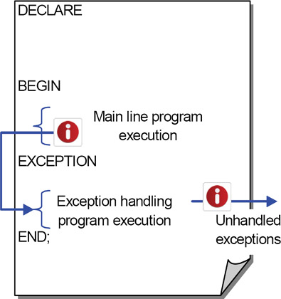
Program Flow with Exceptions

Slide 9
Exception-Handling Section
Syntax
EXCEPTION
WHEN exception_name
THEN
error-processing statements ;
DECLARE
v_num1 INTEGER := :bv_n1;
v_num2 INTEGER := :bv_n2;
v_result NUMBER;
BEGIN
v_result := v_num1 / v_num2;
DBMS_OUTPUT.PUT_LINE('v_result = ' || v_result);
EXCEPTION
WHEN ZERO_DIVIDE
THEN
DBMS_OUTPUT.PUT_LINE('A number can NOT be divided by zero!');
END;

Slide 10
Built-in Exceptions
Exception Name | Issues | Error Number
ZERO_DIVIDE | A divisor is equal to zero | ORA-01476
NO_DATA_FOUND | SELECT INTO statement does not return any rows | ORA-01403
TOO_MANY_ROWS | SELECT INTO statement returns more than one row | ORA-01422
VALUE_ERROR | A conversion or size mismatch error occurs | ORA-06502
… | … | …
OTHERS | ANY runtime errors

Slide 11
DECLARE
CURSOR c_customer_state IS
SELECT customerid AS ID, customername AS NAME, customerstate AS STATE
FROM customer_T;
v_customer c_customer_state%ROWTYPE;
v_test_num NUMBER;
BEGIN
OPEN c_customer_state;
LOOP
FETCH c_customer_state INTO v_customer;
EXIT WHEN c_customer_state%NOTFOUND;
DBMS_OUTPUT.PUT_LINE(v_customer.id || ': ' || v_customer.name || ' is in ' || v_customer.state);
END LOOP;
-- v_test_num := 6/0;
CLOSE c_customer_state;
EXCEPTION
WHEN OTHERS
THEN
IF c_customer_state%ISOPEN THEN
CLOSE c_customer_state;
DBMS_OUTPUT.PUT_LINE('the cursor has been closed');
END IF;
END;

Slide 12
Stored Program Units
  The PL/SQL block we have discussed so far are called anonymous block (no name).
  We can save some code blocks and give them names. Call them later.
  Stored Procedure, Functions, Packages.
  Can take input parameters and return values
  Stored in the database directory. Can be called by many users later.
  Example: substr() is a function (extract a substring from the input string)
  select substr(name, 1, 2) from actor;
Output value (first two characters of name)
Name of the function
Input parameters

Slide 13

Stored Procedure
Example:
CREATE OR REPLACE PROCEDURE welcome_msg (p_name IN VARCHAR2)
IS
BEGIN
dbms_output.put_line ('Welcome '|| p_name);
END;
parameter
Mode:
Input or output or both
Data type of the parameter
Main body of the procedure
Running the code will not generate any outputs.
The procedure will be compiled and stored
Procedure name

Slide 14
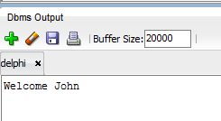
Stored Procedure
Execute the stored procedure. Run the following code in the sql script window.
EXEC welcome_msg ('John');
Execute command
Call the name of the stored procedure
Value of the input parameter (must match data type in the definition)

Slide 15
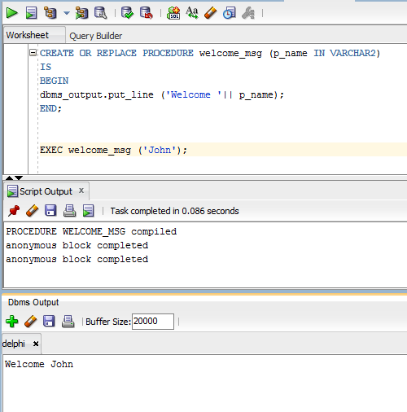
Stored Procedure
1. Compile the stored procedure
2. Compiled successfully.
3. Execute the stored procedure
4. Code completed. Output generated

Slide 16
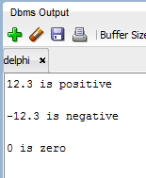
Stored Procedure
Types of parameters:
IN (input): parameter value given to the stored procedure as input. Mandatory.
OUT (output): parameter value generated by the stored procedure as an output. Optional.
IN OUT (both): This parameter is used for both giving input and for getting output from the procedure. Value usually changed in the procedure.
exec num_sign(1.23);
exec num_sign(-3.56);
exec num_sign(0);
CREATE OR REPLACE PROCEDURE num_sign (num IN NUMBER)
IS
BEGIN
IF num >0 THEN
dbms_output.put_line (num || ‘ is positive’);
ELSIF num <0 THEN
dbms_output.put_line (num || ‘ is negative’);
ELSE
dbms_output.put_line (num || ‘ is zero’);
END IF;
END;
exec num_sign(1.23);
exec num_sign(-3.56);
exec num_sign(0);

Slide 17
Stored Procedure
Types of parameters:
OUT (output): parameter value generated by the stored procedure as an output. Optional
CREATE OR REPLACE PROCEDURE plus_one (in_num IN NUMBER, out_num OUT NUMBER)
IS
BEGIN
out_num := in_num + 1;
END;
DECLARE
new_value number;
BEGIN
plus_one(&user_value, new_value);
dbms_output.put_line('The new value is '||new_value);
END;
Call the stored procedure in a PL/SQL block
Input: &user_value (environmental variable)
Output: new_value (declared variable)

Slide 18
Stored Procedure
Types of parameters:
IN OUT (both in put and output): parameter to be updated in the procedure.
CREATE OR REPLACE PROCEDURE plus_one_again (in_num IN OUT NUMBER)
IS
BEGIN
in_num := in_num + 1;
END;
DECLARE
the_num number;
BEGIN
the_num := &user_value;
plus_one_again (the_num);
dbms_output.put_line('The new value is '||the_num);
END;
Call the stored procedure in a PL/SQL block
Input: the_num Takes value from user
Ouput: the_num updated by the procedure

Slide 19
Stored Procedure
You can also use stored procedures to access database tables.
Q. implement a stored procedure to find the total number of products within a given price range (defined by lower_price and upper_price). Display a message to show this number.
CREATE OR REPLACE PROCEDURE search_by_price(lower_price IN INT, upper_price IN INT)
IS
total INT;
BEGIN
SELECT count(*) INTO total
FROM Product_T
WHERE ProductStandardPrice BETWEEN lower_price AND upper_price;
dbms_output.put_line(‘There are ’|| total || ‘ products between $’ || lower_price ||’ and $’ || upper_price);
END;
Declare local variables here. No need to use the “DECLARE” keyword
Test: exec search_by_price(100, 200);

Slide 20
In-Class Exercise
Q. implement a stored procedure (search_by_finish) to find the average price of products with the given finish type. Use the following commands to test the code.
exec search_by_finish(‘Cherry’);
The average price of products with Cherry finish is $250
exec search_by_finish(‘Natural Ash’);
The average price of products with Natural Ash finish is $458.33

Slide 21
Solution
CREATE OR REPLACE PROCEDURE search_by_finish(input_finish IN VARCHAR2)
IS
avg_price NUMBER;
BEGIN
SELECT round(avg(productstandardprice), 2) INTO avg_price
FROM Product_T
WHERE productfinish = input_finish;
dbms_output.put_line('The average price of products with '|| input_finish || ' finish is $' || avg_price);
END IF;
END;
Any problem?

Slide 22
Exercise
Q. implement a stored procedure (search_by_finish) to find the average price of products with the given finish type. Use the following commands to test the code.
exec search_by_finish(‘Cherry’);
The average price of products with Cherry finish is $250
exec search_by_finish(‘Natural Ash’);
The average price of products with Natural Ash finish is $458.33
exec search_by_finish(‘unknown’);
How do you handle this? The message should be “Unknown finish type”
What if the input is an invalid finish type?

Slide 23
Updated Solution
CREATE OR REPLACE PROCEDURE search_by_finish(input_finish IN VARCHAR2)
IS
avg_price NUMBER;
BEGIN
SELECT round(avg(productstandardprice), 2) INTO avg_price
FROM Product_T
WHERE productfinish = input_finish;
IF avg_price IS NOT NULL THEN
dbms_output.put_line('The average price of products with '|| input_finish || ' finish is $' || avg_price);
ELSE
dbms_output.put_line('Unknown finish type');
END IF;
END;
avg_price will be NULL if no products found
EXCEPTION on NO_DATA_FOUND will not work because avg_price has a value (NULL). The error will not be triggered

Slide 24
Stored Procedure
Use stored procedures in a PL/SQL code block. Can you interpret this code?
Calculate the average price of products with the same finish type as the one specified by user
If the specified product does not exist, show ‘unknown finish type’.
DECLARE
finish_type product_t.productfinish%Type;
BEGIN
select productfinish into finish_type from product_t where productid = &pid;
search_by_finish(finish_type);
EXCEPTION
WHEN NO_DATA_FOUND THEN
search_by_finish('unknown');
END;

Slide 25
Stored Functions
Similar to stored procedures with some differences
Must have an output (return value)
Usually used for calculation (vs. stored procedures usually used to perform operations)
Can be called in the SELECT statement of SQL or PL/SQL if the function itself has no SELECT.
No need to feed output variables to the function.
Count(), AVG(), INSTR(), SUBSTR(), CEIL(), FLOOR()… are embedded functions.

Slide 26

Stored Functions
Implement the plus_one procedure as a function. Given a number, return the number plus one.
CREATE OR REPLACE FUNCTION plus_one_func (in_num IN NUMBER)
RETURN NUMBER
IS
BEGIN
RETURN(in_num + 1);
END;
All the stored procedures and functions share the same namespace. No duplicate names allowed. Must use a new name.
Call function from a simple SQL query:
Define the data type of the returned value (mandatory)
select plus_one_func(100) as output from dual;

Slide 27
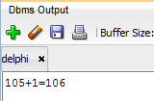
Stored Functions
Implement the plus_one procedure as a function. Given a number, return the number plus one.
CREATE OR REPLACE FUNCTION plus_one_func (in_num IN NUMBER)
RETURN NUMBER
IS
BEGIN
RETURN(in_num + 1);
END;
Call function from an anonymous PL/SQL block
DECLARE
old_num Number := &user_input;
BEGIN
dbms_output.put_line(old_num ||'+1='|| plus_one_func(old_num));
END;

Slide 28
Stored Functions
Return the first word in the given string
CREATE OR REPLACE FUNCTION first_word (input_str IN VARCHAR2)
RETURN VARCHAR2
IS
BEGIN
IF instr(input_str, ' ')=0 THEN
RETURN input_str;
ELSE
RETURN substr(input_str, 1, instr(input_str, ' ')-1);
END IF;
END;
No white space. Single word
Return everything before the first white space.

Slide 29
Stored Functions
Count how many words are there in a given string (number of white spaces + 1).
CREATE OR REPLACE FUNCTION word_count (input_str IN VARCHAR2)
RETURN NUMBER
IS
temp_str VARCHAR2(1000) := input_str;
num_words NUMBER := 0;
BEGIN
IF length(input_str) >0 THEN
LOOP
num_words := num_words + 1;
EXIT WHEN instr(temp_str, ' ') = 0;
temp_str := substr(temp_str, instr(temp_str, ' ')+1);
END LOOP;
END IF;
RETURN num_words;
END;
Number of words so far
If input is empty string, return 0
Add one to word count
Exit loop if no more white space (no more words)
Remove the first word and whitespace
save the remaining string into temp_str

Slide 30
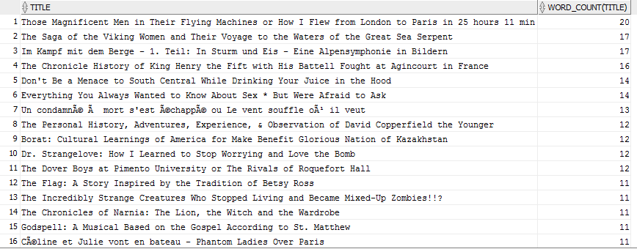
Test the code
select word_count(‘This is an example') from dual;
select title, word_count(title) from movie order by 2 desc;
You can try to modify the code to exclude
Punctuation marks.

Slide 31
Stored Procedures vs. Functions
Procedure | Function
Used mainly to a execute certain process | Used mainly to perform some calculation
Cannot call in SELECT statement | A Function that contains no DML statements can be called in SELECT statement
Use OUT parameter to return the value | Use RETURN to return the value
It is not mandatory to return the value | It is mandatory to return the value

